Slide 1
PreCog Task Presentation
Citation Graph Analysis
By Hari Aakash K

Slide 2
Contents
Graph analysis — In this task I analyzed various properties of the graph and tried to gain information the general structure of the citation networks.
Community Detection — Here, I used three different approaches to find communities in the graph. I implemented two of the approaches and used a library for the third approach.
[Bonus Task] Link Prediction — Here I used the embeddings I trained for the graph using the Node2Vec model to train a model to make predictions about the edges of the graph. Here I experimented by adding additional information about the nodes of the graph to train with. I was not able to implement a graph neural network for this task. Instead I had compared the performances across the various models I had trained.

Slide 3
Graph Analysis
Basic information about the data:
There are 34546 nodes. But the id of the nodes are not numbers in the range [0, 34546].
Some papers may contain multiple dates. The most likely reason behind this would be because of future revisions of the same paper. In this case, the earliest publication of the paper was used in the analysis.
Some papers do not contain any publication date. The options to deal with such papers where to either ignore them, choose a date before or after all papers or choose the median date. The two choices I felt were ideal were to ignore them or to choose a date after all papers. I tried both of these options. The analysis with the maximum date has been presented here.

Slide 4
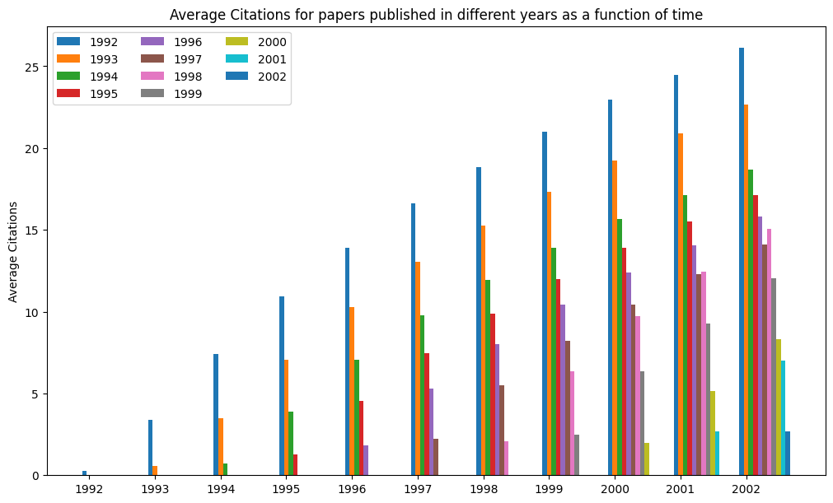
The indegree of the nodes of the graph represents the number of times a paper has been cited.
First I tried to look at the average citations of the papers. I analyzed the papers by splitting them into buckets labelled by the year they were published in and also looked at the growth of the average citations each year after they were published.

Slide 5
As expected, the average citations of the papers released in a particular year increases over time. And not very surprisingly, the papers released earlier tend to have more average citations.
There could be two major reason why the average citations are greater.
(i) These papers are more fundamental
(ii) The higher number of citation is only due to the papers being around for a longer period of time
To test these possibilities out, we can correct for the number of years the paper has been out by dividing the computed average by it.

Slide 6
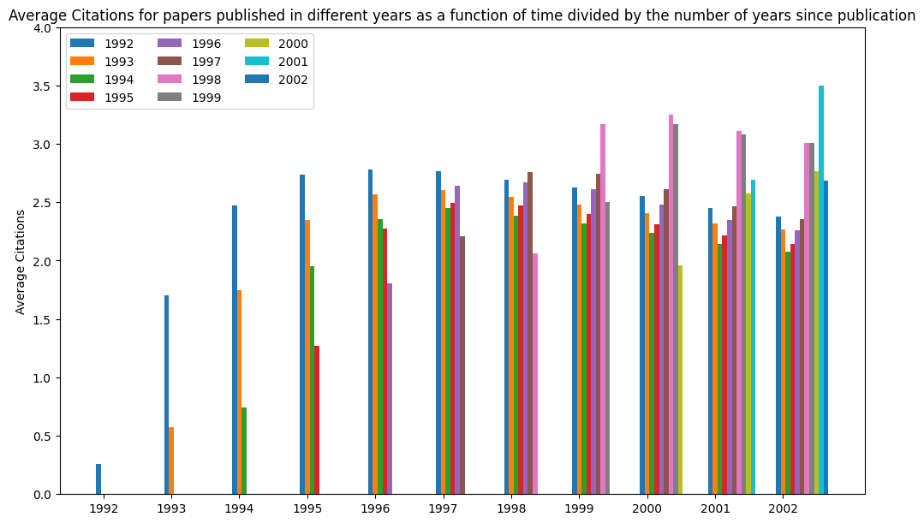

Slide 7
This normalized graph showcases that possibility (ii) is the most prevalent reason as to why a paper might be sighted more often.
Though newly released papers have lower number of citations when they first come out, they eventually catch up to have around the same average number of citations as any older paper.
Infact, some of the newer papers tend to have a higher value in the graph.
The possibility (i) may not have much of an impact here because most of the “foundational” work in high energy physics would be long established before the years of this dataset.

Slide 8
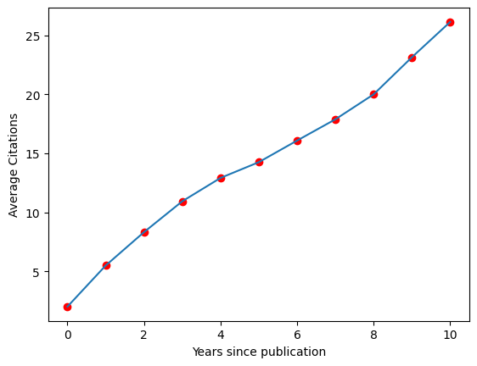
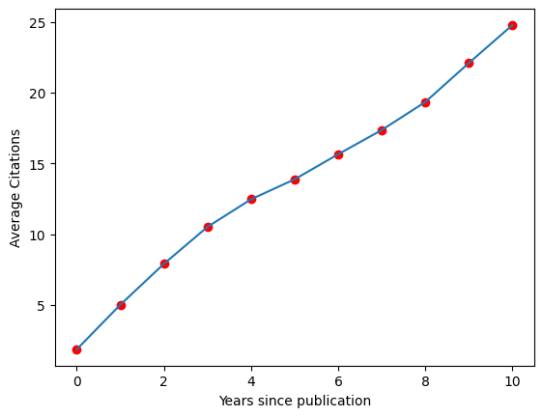
Another piece of information that I thought would be interesting to see about the dataset would be the average citations of a paper vs the number of years since publication.
The plot is almost linear agreeing with what we can infer from the previous graph. There seems to be a slump in the slope between years 5 to 8 for the plot on the left and from years 5 to 10 for the plot on the right. The reason why the slump recovers in the later years for the graph on the left is because a lot of extra papers are added to the last year in the plot on the left.
When the nodes with no dates are given maximum dates.
When the nodes with no dates are ignored..

Slide 9
Another piece of information which I thought was interesting was the number of days between the first version of a paper and the first version of a paper it cites.
I plotted a histogram showcasing the frequency of different days between papers. The intervals of the histogram are given below:
[-2698. , -2571.5, -2445. , -2318.5, -2192. , -2065.5, -1939. ,
-1812.5, -1686. , -1559.5, -1433. , -1306.5, -1180. , -1053.5,
-927. , -800.5, -674. , -547.5, -421. , -294.5, -168. ,
-41.5, 85. , 211.5, 338. , 464.5, 591. , 717.5,
844. , 970.5, 1097. , 1223.5, 1350. , 1476.5, 1603. ,
1729.5, 1856. , 1982.5, 2109. , 2235.5, 2362. , 2488.5,
2615. , 2741.5, 2868. , 2994.5, 3121. , 3247.5, 3374. ,
3500.5, 3627. ]

Slide 10
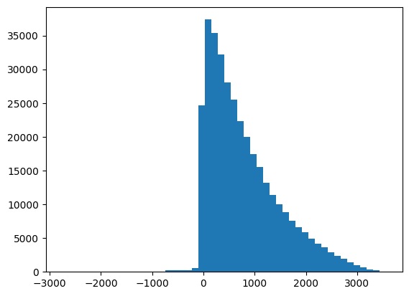
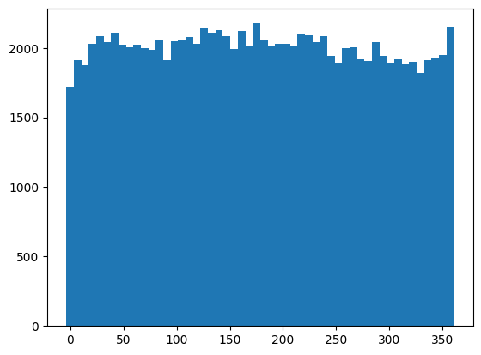
Cleary, most of the citation pairs are not very far apart. They are often less than a year from each other.
Zooming in on the range [0, 364] gives us a very uniform plot.
Note: For this plot, we have ignored all the nodes that do not have dates.

Slide 11
Next I wanted to look at the connected components of the graph. More precisely, since we are dealing with a directed graph, this can be termed as the weakly connected components of the graph.
Two nodes will be in the same weakly connected component iff they are linked to each in some way. This link might be very remote but any pairs of papers which have some remote connection between each other will be a part of the same component.
Since high energy physics is a relatively specialized field, I expected most of the papers to be linked to each other and the number of connected components to be very low.

Slide 12
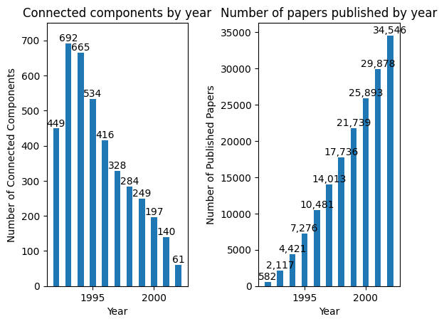
But there seems to be quite a lot of connected components.
Additionally, the number of connected components seems to be surprisingly large in the year 1993.
1993 seems to be the sweet spot where there are enough papers to form many different connected components but not enough to have a lot of these components connected to each other.

Slide 13
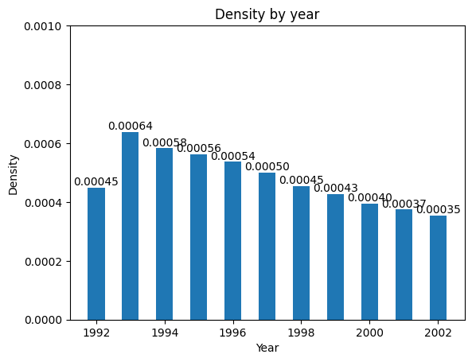
A plot of the density of the graph might help us confirm our hypothesis.
For directed graphs, density can be defined as (number of edges)/(number of nodes * (number of nodes - 1)).
More connected components would likely mean less number of edges connecting the nodes.Since 1993 had the most number of connected components, it must have the minimum density.
This plot seems to go against my hypothesis. The opposite seems to be true.

Slide 14
Analysis of individual connected components revealed insight into why we might arriving at such results.
Analyzing the components of the graph in the year 1993, we can see that there is one very dense component containing a lot of the nodes of the graph. The rest of the nodes form many smaller components.
A similar trend is observed for the graphs of all the other years too. But the reason why the graph of 1993 has the most number of connected components is because the percentage of the total nodes in the largest component is much lower for the graph of 1993 compared to the other years.
The plots in the next pages showcase these facts.

Slide 15
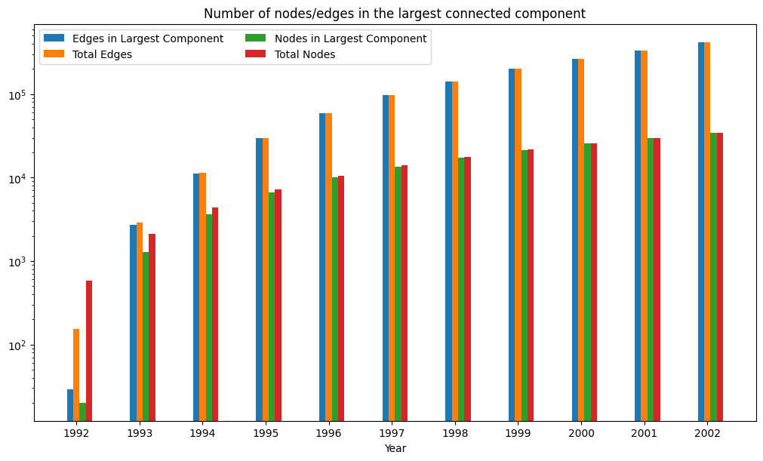
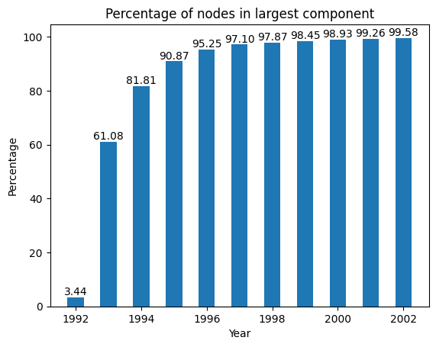
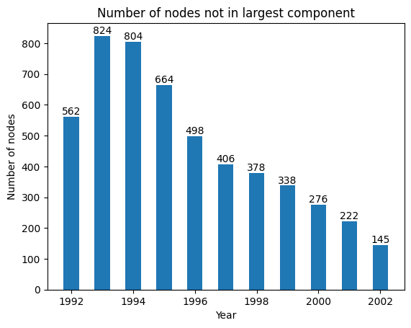
The shape of the plot describing the number of components matches very well with the graph on the left. Though as expected a lot of the papers in these fields are linked to each other, there are a few isolated groups of nodes scattered. These could possibly be papers which diverge from this field.

Slide 16
While dealing with connectivity, we can try to look at the Strongly Connected Components(SCCs) of the graph too.
The fact that SCCs exist initially surprised me. For an SCC to exist a cycle in the graph should exist. If we go with the assumption that a paper can only cite a paper released before it, a cycle cannot exist.
The reason cycles exist is because the assumption that papers can only cite past papers is false. Looking at multiple dates for some papers, it was clear that different versions of papers may be published on different dates. And in a future version a paper can cite a paper which was published after its initial release (which could have potentially cited this paper).

Slide 17
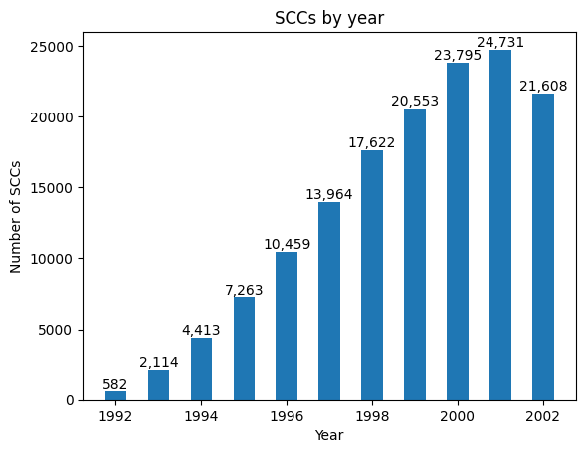
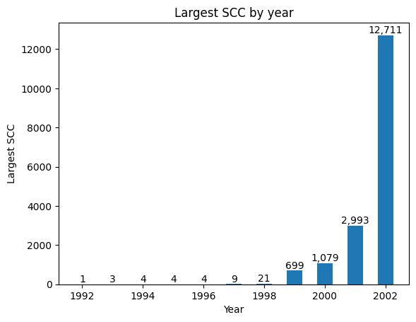
In the first few years, almost all nodes are a part of a separate SCC. The number of SCCs is almost equal to the number of nodes. In the laters years there are some large SCCs formed. Especially in the last year a lot of edges connecting past papers are added forming a very large SCC.

Slide 18
Finally, I wanted to analyze the distances of the nodes in the graph. This was relatively harder task to deal with since the number of operations required to gain interesting information about the graph was O(n^3).
Further, a lot of interesting properties dealing with distances are only defined for SCCs of the graph.
The one property that I thought would be interesting to visualize was the maximum eccentricity among all nodes of the SCC. Eccentricity of a node is the maximum distance between that node and another node in the graph.
I found the maximum eccentricity among all the nodes of the graph after each year. Since the largest SCCs are large enough only 1999 1999, the plotted values are interesting only from 1999.

Slide 19
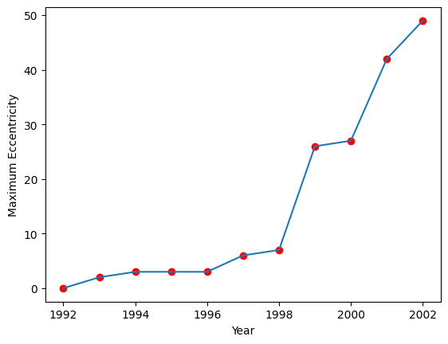
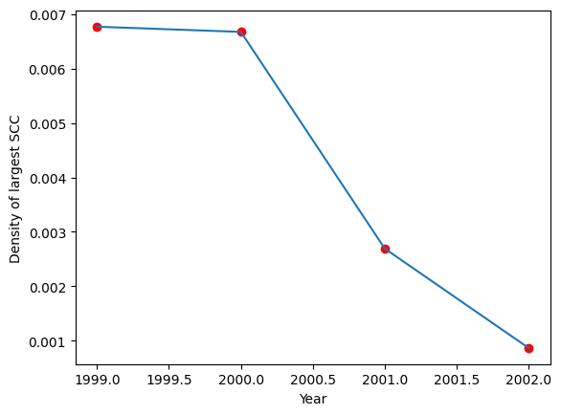
The graph shows a general increase in eccentricity. Since the maximum eccentricity of a graph is somewhat related to the density of the graph, I thought it would be interesting to plot the density of the SCCs.
Interestingly the plot of the density of the SCCs in the last 4 years seemed to be almost the inverse of the plot of the maximum eccentricity in the same time. This makes sense since lower number of edges relative to the nodes would likely imply the existence of a very large eccentricity.

Slide 20
Community detection
In this task we are required to group nodes of the graph into communities. I used three approaches to do the same. I implemented two of them and used a python library for the third.
Approach 1: Based on the paper Fast unfolding of communities in large networks
Approach 2: Based on the embeddings I tried using the Node2Vec architecture.
Approach 3: An information theoretic approach based on this paper.

Slide 21
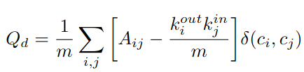

Fast unfolding of communities in large networks
In this approach we use greedy heuristics to increase the modularity of the graph. Though modularity and the approach in the paper is defined for undirected graphs, we will use the modification of modularity as mentioned in the following paper [3].
δ(c_i, c_j) = 1 iff both c_{i} and c_{j} are part of the same community. The term
roughly represents the probability of the existence of edge from k_{i} to k_{j}. Each term of the summation has a high value if an edge exists when the probability of the edge existing is low. This can be interpreted as nodes belong to the same community if they share an edge against all odds.

Slide 22
The greedy algorithm to form communities which increase the modularity proceeds as follows. The algorithm proceeds in two steps.
Step 1: We loop through each of the nodes of the graph and attempt to add this node to one of the adjacent communities. For a undirected graph, the paper defines adjacent communities to be those which share an edge with our current graph. Here, since we are dealing with directed graphs, I considered both predecessors and successors of the current node to be adjacent. We try to add the node to each of the adjacent communities and calculate the new modularity. We move this node to the community which gives the maximum gain in modularity.
Step 2: Then we the nodes of each community to form a new graph. The indegree and outdegree of the nodes of the new graph would be the sum all the nodes inside the community which is represented by a particular node.
These steps are repeated till the point we cannot achieve an increase in modularity.

Slide 23
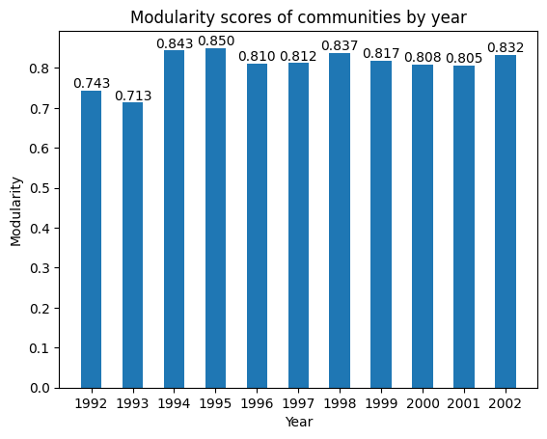
My implementation of this algorithm takes about 30 seconds to run for the given graph with 34546 nodes and 421578 edges.
This model gives a very good modularity score over 0.8.
Next I tried to run the same algorithm over the graph across different years. I plotted various plots describing the communities formed for these graphs.
First I tried to plot the modularity of the graph over the years. The modularity of the graphs seem to be in the range 0.71 to 0.85.

Slide 24
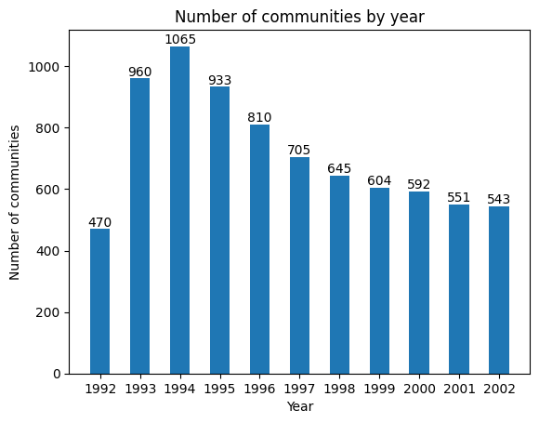
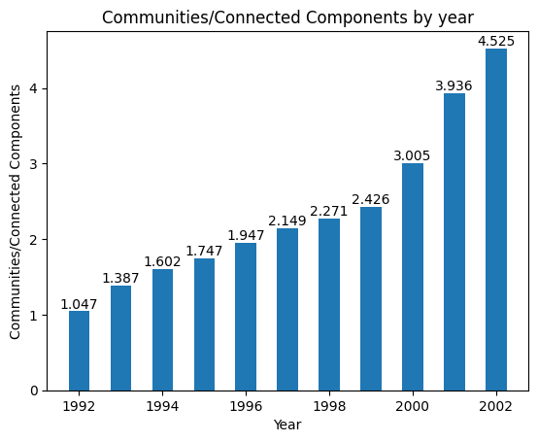
The communities/connected components graph increases with year. This makes sense as the number of nodes in the largest connected component increases with time and intuitively it would make sense for these components to have more communities.

Slide 25
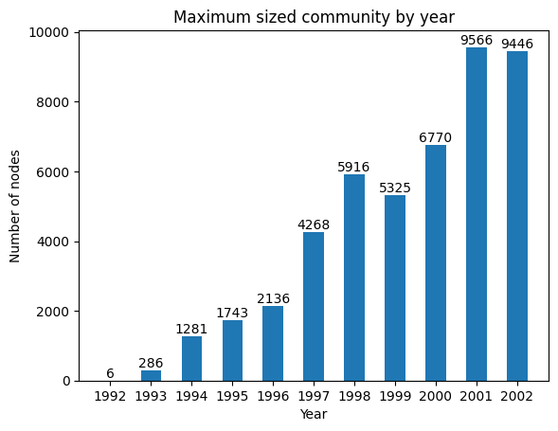
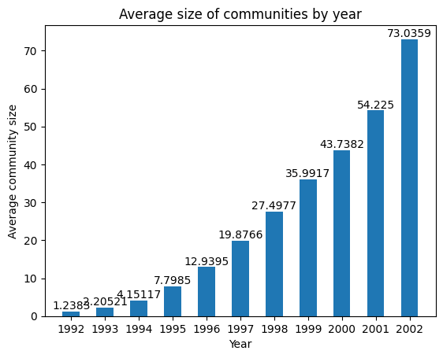
The plot representing the average size of communities showcases a gradual increase over time as expected.

Slide 26
Node2Vec
First I started by creating the node embeddings for this graph.
A lot of the following steps are based on the work presented in the paper describing Node2Vec [4].
According to the paper, we do biased random walks of the graph to get the nodes which are the context of a particular node. Following this we create positive and negative pairs of nodes and train using this data. This is similar to how the skip-gram architecture works in Word2Vec.
We pair each node with all the other nodes within its context window in a random walk.
Due to computational limits, I used only about one third of the data to train on.

Slide 27
My modifications to train the embeddings:
The biased random walks mentioned in the paper should work very well for undirected graphs. But for directed graphs since the existence of a back edge from the current node to its parent is not guaranteed, the likelihood of visiting nodes in the ‘BFS’ order is reduced. To combat this, I introduced a new parameter r along with p and q. We would loop through each of the predecessors of a particular node and we can traverse that edge backwards with a probability of 1/r. I set r to be larger than both p and q. While training the embeddings, I set p and q to be both equal to 1 and r to be equal to 10.
Since forming all possible pairs of nodes from the context spaces of walks to be positive examples took too much time and created too many training examples, I formed pairs of two types.
For the origin node of a random walk, I paired it up with every node in the current walk.
Additionally, I chose 9 random nodes from a walk and paired them up with other random nodes from this walk.

Slide 28
Additionally, the length of the random walks increase after each iteration. This strategy seemed to combine well with the idea to randomly pick pairs of nodes from the random walk. This is because the walk lengths mixed both exploration of nodes which are far apart while prioritizing the nodes which are closer. Random selection from such walks gave a good set of training examples.

Slide 29
Once the embeddings were trained, I had to find a way to cluster similar vectors together. First I tried to implement a few heuristics to cluster similar nodes with high dot product together. This did not work very well.
Next I moved to using the k-means clustering algorithm. This algorithm seemed to work pretty well. Though this method did not optimize for modularity, it gave a pretty good modularity score when k was set to 20. It gave a score of 0.61 in this case.
k | Modularity
10 | 0.75
20 | 0.61
50 | 0.46
100 | 0.30

Slide 30
k = 20 is the value that I chose to be ideal as it gives enough communities while also giving a high value of modularity.
The one weakness of this approach is that smaller isolated connected components will almost never be part of a separate community. Though this might not be what we desire. This is because with smaller values of k, it is almost never going to be optimal to allocate a centroid exclusively for a connected component.
A solution to deal with this would be loop through each component of the graph separately and perform K-means clustering on that component. The K for each component could be proportional to the number of nodes in the component.

Slide 31
InfoMap
The idea behind this approach is from this paper [5].
The library I used for this approach is the following [6].
This was an approach that I found very interesting. Here the walks are represented using Huffman encodings and we aim to minimize the length.
This intuition made a lot of sense. I was not able to code a well optimized approach that would run fast enough using this approach. That is why I went to using the library instead.

Slide 32
In this we would like to use Huffman encodings to minimize the length of bit strings required to represent random walks.
In this strategy we split the nodes into communities such that each of the nodes inside the communities are common prefix free. But they can share prefixes across communities. Additionally each community has a prefix and suffix indicating entry time into the community and exit time from it.
It is ideal to not encounter too many of the prefix and suffix encodings. So, the communities are optimized such that the random walks do not enter or exit a community too often. Instead it enters a community, walks within it for a period of time before exiting.
This approach gives a respectable modularity of 0.582

Slide 33
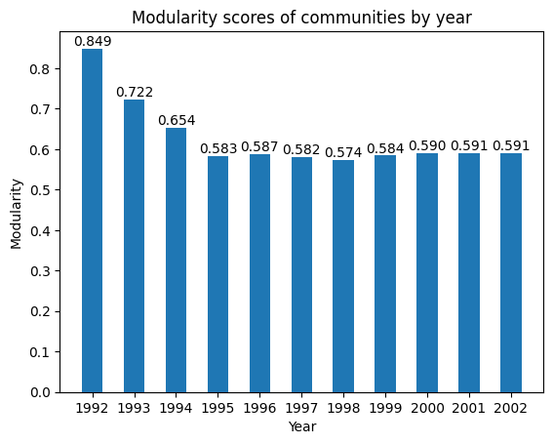
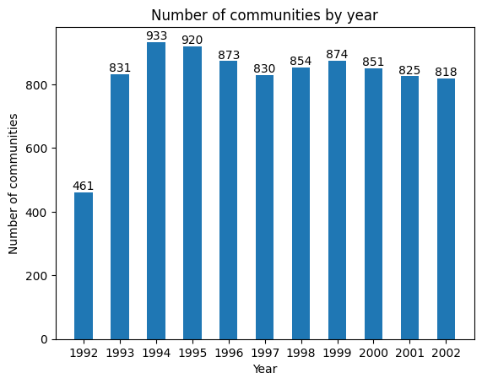
Interestingly, the modularity of this approach seems to be very high for the graph formed in 1992. The modularity here is even higher than the modularity achieved by the modularity optimizer.
The number of communities formed by this approach in 1993 is lesser than the number of communities formed by the modularity optimizer. This value is very close to the number of connected components. The reason behind the higher modularity score might be linked with the number of communities formed. In 1992, almost all nodes in a connected components except the sparse components seem to be part of a single community.

Slide 34
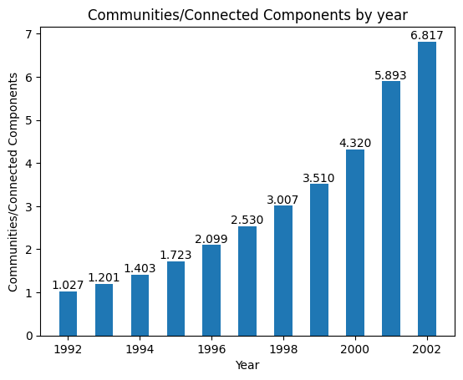
The communities/connected components ratio increases quite fast. For the later years, the ratio exceeds the previous model. The reason behind this might be because optimizing modularity for relatively sparse graphs might encourage the model to club together a lot of nodes. Whereas detecting communities based on the random walks as used in this approach might lead to more localised communities.

Slide 35
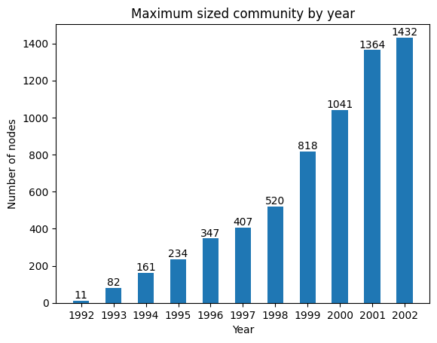
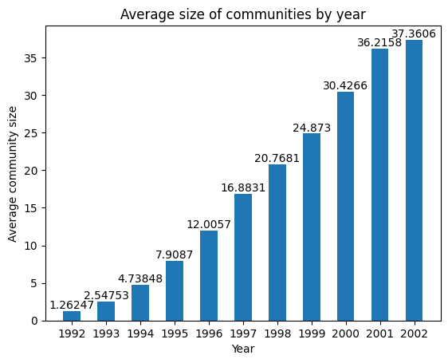
The increase in the maximum community size is more consistent for this model.
The average community size is lower than the previous model as expected. This makes sense as the number of communities formed by this model is greater than the previous model.

Slide 36
Visualization
Visualizing the communities of such a large graph seemed to be a very hard task.
Preserving the structure of such a large graph and meaningfully displaying the communities on it seemed to be very hard.
Instead, a solution I came up with was using the node embeddings of the graph. Using PCA, the node embeddings can be compressed and visualized in a 3D space. Colouring the nodes according to the community they belong to would give us a meaningful visualizing.
The visualization was done using the following application: https://projector.tensorflow.org/

Slide 37
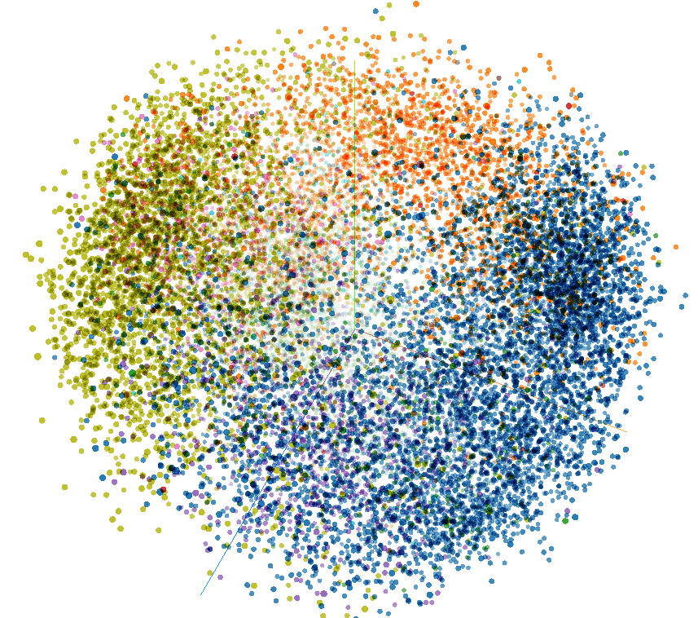
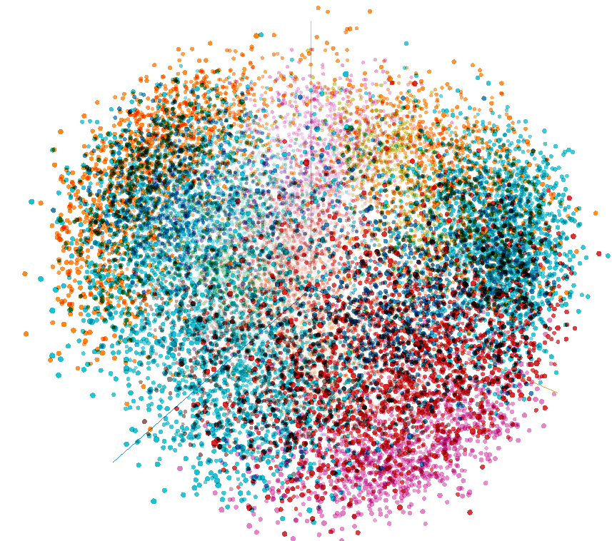
Using the modularity optimizer
Using K-Means and Node2Vec

Slide 38
Link Prediction
For this task, I trained a Neural Network using the previously trained node embeddings as inputs.
The nodes and edges of the graph upto 1999 is used as the training data and the nodes and edges following that are used for testing.
All the edges of the training graph are added as positive examples to the training data. Additionally random pairs of nodes which are not connected are added as negative examples.

Slide 39
The embeddings of the nodes of a pair in the training data are concatenated to form the input vector. Additionally, the date of the first version and the date of the last version of both these nodes are converted to integers and are normalized and appended to the input vector.
The model was trained using tensorflow and the architecture is given below.
Layer (type) ┃ Output Shape ┃ Param # ┃
┡━━━━━━━━━━━━━━━━━━━━━━━━━━━━━━━━━╇━━━━━━━━━━━━━━━━━━━━━━━━╇━━━━━━━━━━━━━━━┩
│ dense (Dense) │ (None, 256) │ 52,480 │
├─────────────────────────────────┼────────────────────────┼───────────────┤
│ dropout (Dropout) │ (None, 256) │ 0 │
├─────────────────────────────────┼────────────────────────┼───────────────┤
│ dense_1 (Dense) │ (None, 512) │ 131,584 │
├─────────────────────────────────┼────────────────────────┼───────────────┤
│ dropout_1 (Dropout) │ (None, 512) │ 0 │
├─────────────────────────────────┼────────────────────────┼───────────────┤
│ dense_2 (Dense) │ (None, 256) │ 131,328 │
├─────────────────────────────────┼────────────────────────┼───────────────┤
│ dropout_2 (Dropout) │ (None, 256) │ 0 │
├─────────────────────────────────┼────────────────────────┼───────────────┤
│ dense_3 (Dense) │ (None, 128) │ 32,896 │
├─────────────────────────────────┼────────────────────────┼───────────────┤
│ dense_4 (Dense) │ (None, 1) │ 129 │

Slide 40
ReLU activation is used in the hidden layers and sigmoid for the final layer.
Though this model worked well with about 92% accuracy on the randomized test data, it seemed to fail on specific test cases. In particular, the model failed on test cases where we try to predict the existence of an edge between the same node. Since the model seems to use the similarity between the embeddings as a major factor, it predicts with high certainty that a link exists even when it doesn’t.
To fix this issue, I included negative examples of the form (node, node) to both the training and test dataset. This change seemed to fix this issue quite well. Finally the model worked with an accuracy of over 94% on the test data.

Slide 41
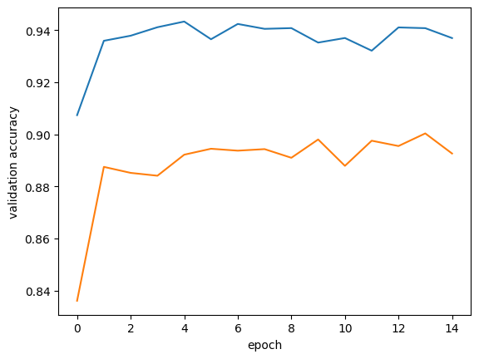
Next I was curious about the impact of dates on the predictions. I tried to train a model with the dates removed. This model’s performance was significantly lower than the previous model. The accuracy that this model achieved was slightly over 89%.
This model fails to predict the direction of edges correctly. That is, very often when an edge x->y exists, it predicts that y->x exists too. This could potentially be fixed by training on a lot of negative test cases for the above case, but adding dates to the vector makes it easier for the model to capture such relations.
Orange line is the model without dates.

Slide 42
Paper Presentation

Slide 43
Node2Vec
This paper describes a method to compute Node Embeddings using an architecture very similar to the Word2Vec model used to compute Word Embeddings.
In Word2Vec, the “context” of a word is derived from the words surrounding it in a sentence. In a graph there is not obvious way to derive such a context. Random walks across the graph gives us the required context around each node.
The paper DeepWalk uses similar random walks to generate the context walks and trains the model on them. But in this paper the random walks are biased. The walks are biased to control the “BFS” and “DFS” nature of the walks.
Two parameters introduced in the paper help us control the bias of such walks. This helps the trained vectors capture both structural and homophilic(same community) equivalences in the graph.

Slide 44
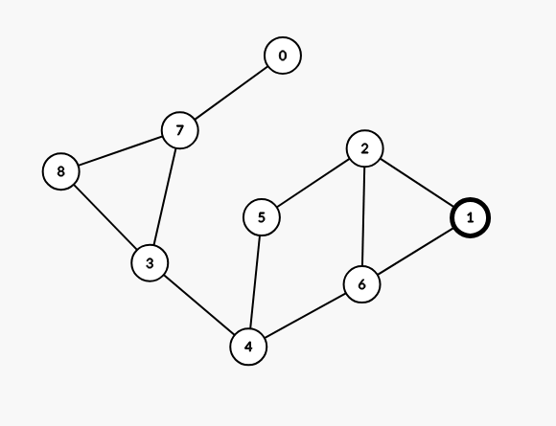
For simplicity, let’s deal with unweighted graphs. For weighted graphs, the probabilities can be multiplied by the the weights and normalized.
Say we are currently at a node u and we reached here from a node t. The probability of walking to a node v in the next iteration is a factor of:
1/q if v = t,
1 if v is adjacent to t
and 1/p otherwise.
A lower value of q would imply that the probability of going back to the previous node is higher and the “BFS” like traversal is prioritised. This might help in capturing the structural relations of the graph better.
A lower value of p would encourage more exploration in the walks. A more DFS like traversal is prioritised here.
In this graph, a lower value of q starting at node 1 might prioritize walks like this: 1->2->1->6->4->6->2->5
Whereas a lower value of p would prioritize walks like this:
1->2->5->4->3->8->7->0

Slide 45
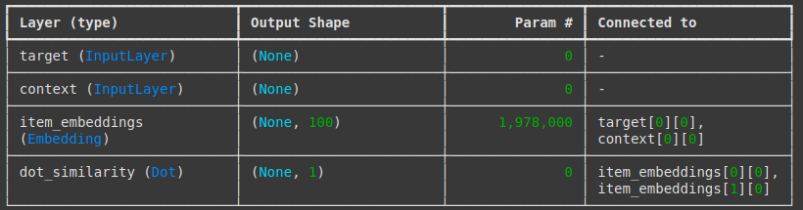
Steps of the algorithm:
For each node, perform n biased random walks starting from that node. To choose the next node in a walk according to probabilities, we use the Alias method. To choose an element on a list with m elements according to fixed probabilities, we can use this method. With O(m) preprocessing, we can query for elements in O(1) time.
Fix a context window length k and construct training pairs by looping through the nodes of the walk and pairing them with every node in the `k-window` of that node in the walk. Additionally construct negative examples by pairing two random nodes in the graph.
Assign random embedding vectors to each node. For every pair of nodes in the training data the embeddings of the node are selected. The dot product of these embeddings are computed. For positive examples, the dot product needs to be high and for negatives it needs to be low. The embeddings are updated to optimize these predictions.
The paper also provides ways to derive edge embeddings from the node embeddings. This is done by performing some binary operation on the nodes an edge connects.
This model adapts the ideas of the DeepWalk model while adding flexibility to the amount exploration the walks would perform.
This model contains a lot of hyperparameters and the paper contains plots showcasing these hyperparameters.

Slide 46
Strengths of the paper
The paper presents a method which is very easy to train and scales linearly with graph size.
Node2Vec enables training quick numeric representation for the nodes which can be very useful to visualize large graphs. Visualizing the node embeddings using PCA in a 3D or 2D space can reveal interesting information about the relationship between the nodes in the graph.
The hyperparameters p and q give a lot flexibility. This enables us to train embeddings to capture specific information about the graph.

Slide 47
Weaknesses of the paper
The method mentioned in the paper works very well for connected undirected graphs. But the performance of the model on directed graphs is not tested. The paper doesn’t cover how the model would process unconnected nodes. It does not allow any way to relate two disconnected nodes.
The effect of hyperparameters p and q are very interdependent and could have perhaps been merged into a single hyperparameter without losing too much of the flexibility.
The paper does not explore the idea of having variable walk lengths. Exploring the performance of the model with lower walk lengths at the beginning and increasing the lengths in the future iterations would have been interesting.

Slide 48
Possible Improvements to the paper
Introduce a way to traverse to predecessors of a node with small probabilities. This would also ensure that the case where a node has no successors doesn’t cause a problem. Exploring how the model tackles undirected graphs would have been interesting.
Trying to replace p and q with a single hyperparameter and comparing the performance.
Experimenting with variable walk lengths. The walk lengths could perhaps start small and later increase into larger values. This would simulate the effect of exploring closer nodes in the initial iterations while exploring nodes which are further away later.

Slide 49
References
https://matplotlib.org/stable/gallery/index.html
https://arxiv.org/pdf/0803.0476
https://www.mapequation.org/assets/publications/RosvallBergstromPNAS2008Full.pdf
https://arxiv.org/pdf/1308.0971
https://www.researchgate.net/publication/362459677_Community_detection_methods_for_directed_graphs/fulltext/64f6965a827074313ffd97b6/Community-detection-methods-for-directed-graphs.pdf
https://www.pnas.org/doi/epdf/10.1073/pnas.0706851105

Slide 50
https://pypi.org/project/infomap/
https://projector.tensorflow.org/
https://keras.io/examples/graph/node2vec_movielens/
https://github.com/asmith26/Vose-Alias-Method
https://networkx.org/documentation/stable/reference/

Slide 51
Thank you!

